Slide 1
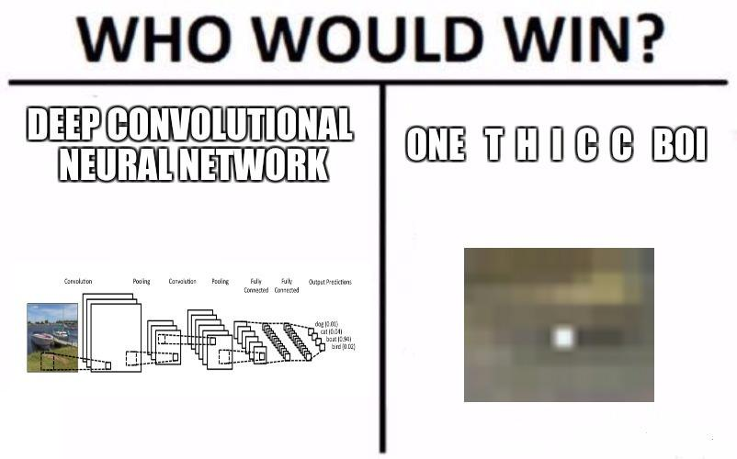
CNN與FGSM的慘烈修羅場
Image Recognition Attack and Defense
Group 26
Notes:
Hello everyone, this is group 26. Our topic is image recognition attack and defence.

Slide 2
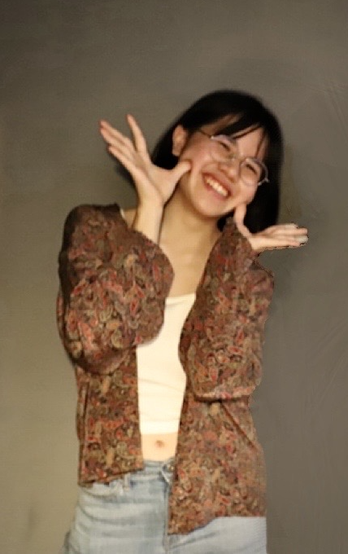
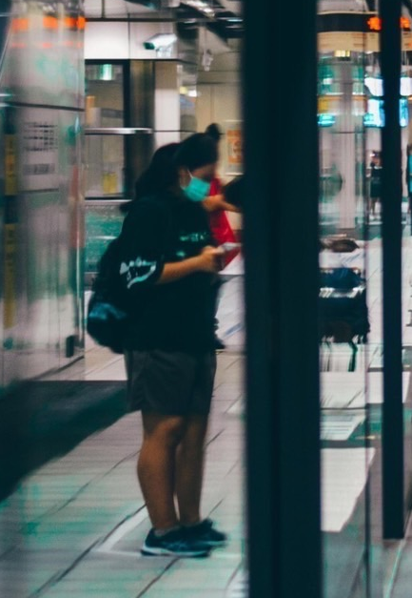
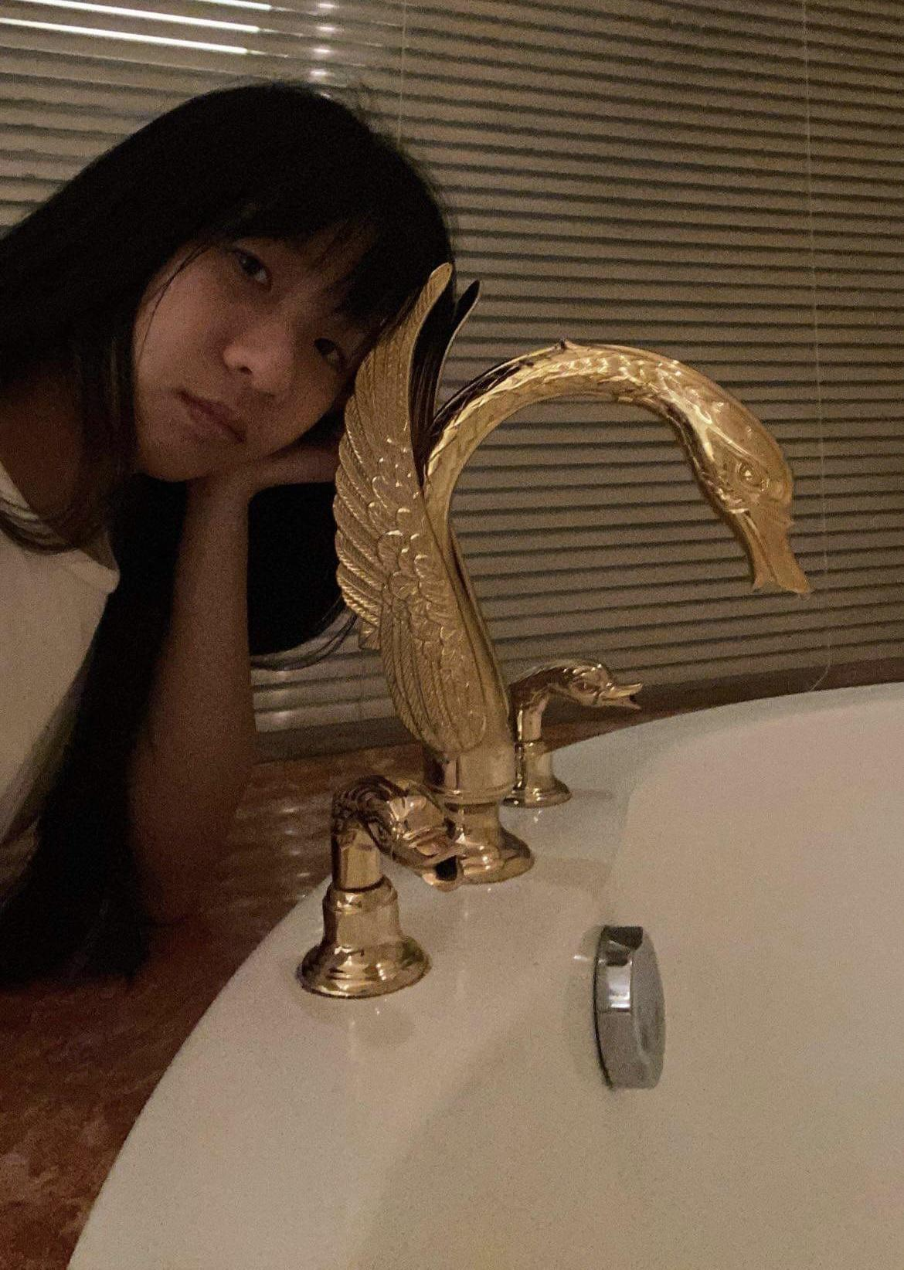
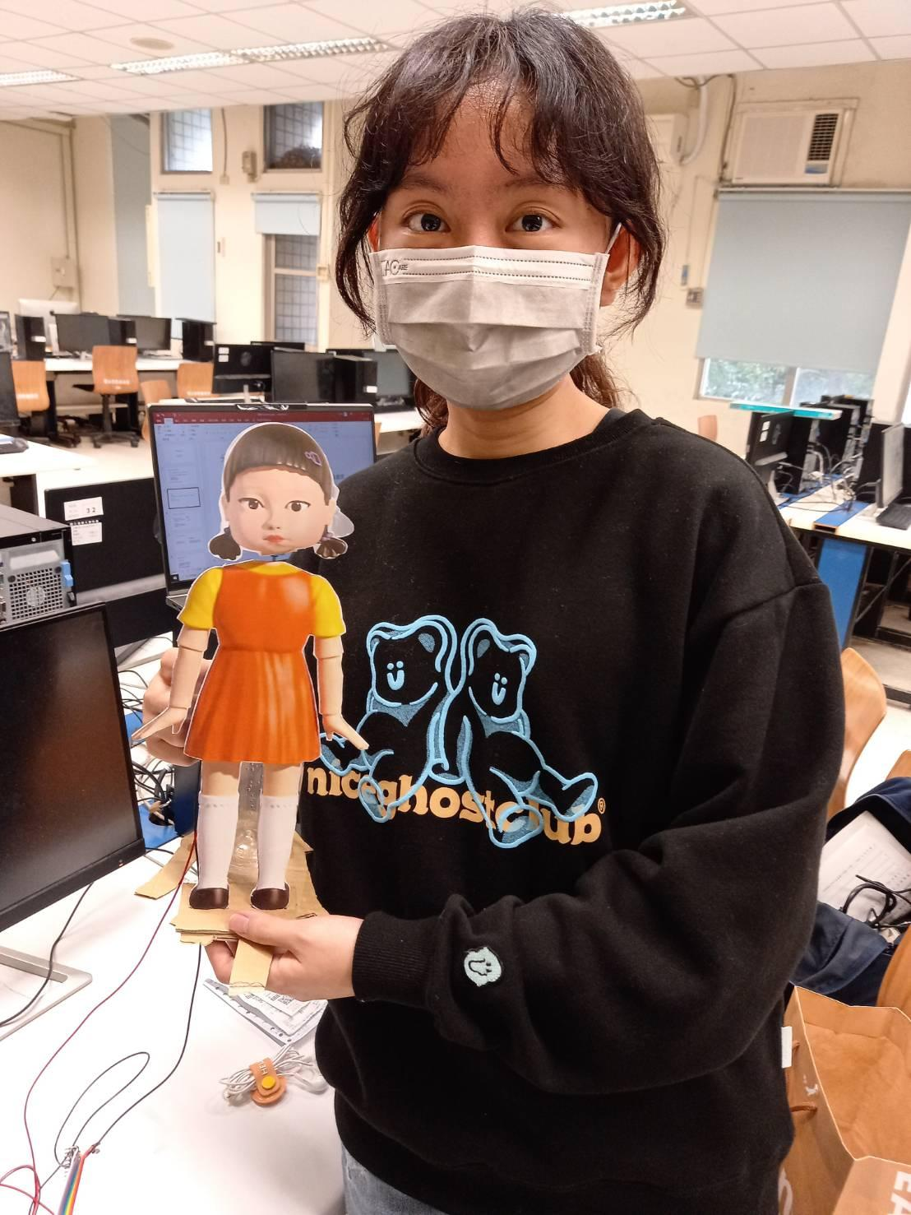
Members
鄭幸怡
109062305
段欣妤
109062313
何苡歆
109062306
葉明淳
109062140
Notes:
These are our members.

Slide 3
Our Goal
Train a model that identifies animal category
Use adversarial examples to attack the model
Find ways to defense the attacks
Notes:
Our goal is to train a model that identifies animal category, generate adversarial examples to attack the model, and find ways to defense the attacks.

Slide 4
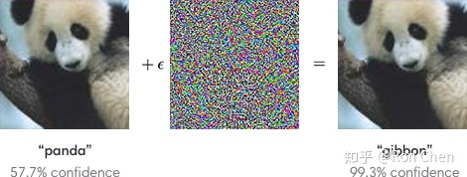
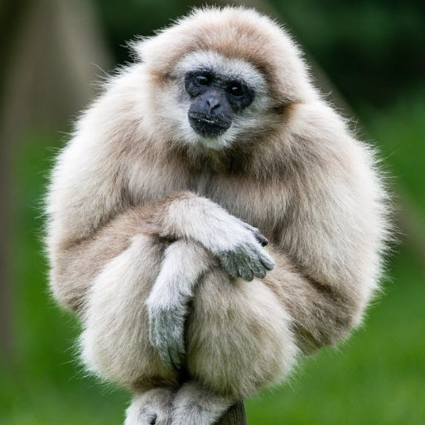
What is “adversarial example attack”?
Adversarial examples : specialised inputs created with the purpose of confusing a neural network, resulting in the misclassification of a given input.
real “gibbon”
Here, with the image of a panda, the attacker adds small perturbations (distortions) to the original image, which results in the model labelling this image as a gibbon(長臂猿), with high confidence.
Notes:
First, what is adversarial example attack?

Slide 5
Method
Use CNN to train a model
Generate adversarial examples
Limited-memory BFGS (L-BFGS)
Jacobian-based Saliency Map Attack (JSMA)
Deepfool Attack
Generative Adversarial Networks (GAN)
and more ……
Notes:
These are our methods. We use CNN to train model, and use these methods to generate adversarial examples.
https://viso.ai/deep-learning/adversarial-machine-learning/

Slide 6
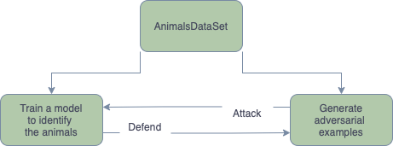
Process Flow
Notes:
This is our flow chart, we first train model and generate adversarial examples on the same dataset, then do the attack & defense.
After doing so, we can try different ways to attack. For example, Generate adversarial examples without using same dataset, to simulate the condition that attackers don’t have the same dataset.

Slide 7
Schedule
Mid November ~ mid December:
Data prepeocess &Train model
Do research on adversarial example attack.
Mid December ~ late December:
Defend attack.
Early January
Write report.
Notes:
照唸

Slide 8
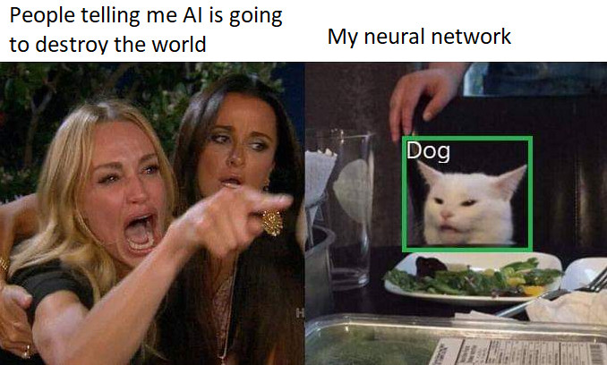
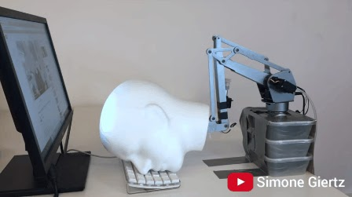
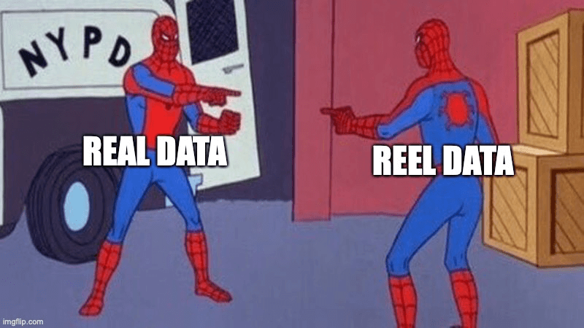
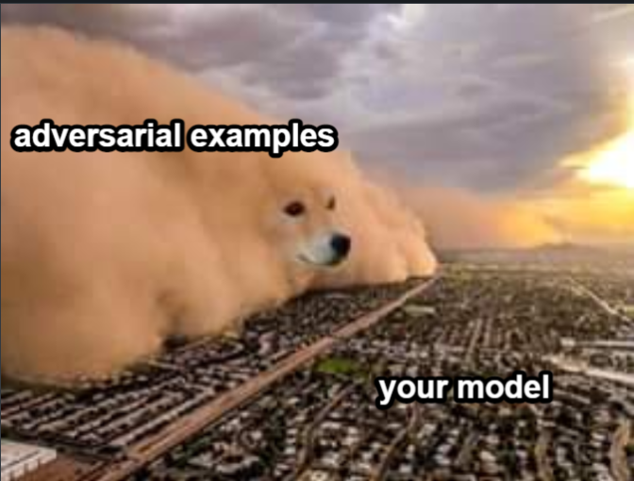
The End

